Slide 1
Project CAD
Signal generator
Theme: Square and triangle signal generator
Hancis Bogdan
Group 2023

Slide 2
Definition
A signal generator is piece of test equipment that produces an electrical signal in the form of a wave. This is used as a stimulus for the item being tested. Signal generators in all their forms are widely used within test and development systems, being used with other test instruments.

Slide 3
History
In the 1920s and 1930s, signal generators were primarily used in radio and telecommunications applications, such as testing and calibrating radio transmitters and receivers. These early signal generators were simple in design and typically produced sine waves.
During World War II, the use of signal generators expanded significantly as they became essential tools in the development and testing of radar systems. Signal generators were used to generate pulse signals for radar systems, which allowed for the detection of objects at greater distances and with greater accuracy.

Slide 4
In the post-war period, the development of solid-state electronics led to the miniaturization of signal generators and the expansion of their capabilities. By the 1960s, signal generators had become indispensable tools in a wide range of applications, from telecommunications and radar to audio and video production.
Today, signal generators continue to evolve and become more sophisticated, with the development of new technologies such as digital signal processing, software-defined radio, and high-speed data transmission. These advances have enabled the creation of signal generators that can produce complex waveforms, modulated signals, and even emulate real-world signals, making them essential tools in a wide range of fields, including electronics, communications, and aerospace.

Slide 5
Purpose
The purpose of a signal generator is to produce electronic signals of various types, frequencies, and amplitudes. It is commonly used in electronics, telecommunications, and research laboratories for a range of applications, including testing and calibrating electronic equipment, troubleshooting circuits, simulating real-world signals, and conducting experiments. Signal generators are versatile tools that enable precise control and generation of signals for a wide range of purposes in different industries and fields.

Slide 6
Types of signal generators
Function Generators: These signal generators are designed to produce simple waveforms such as sine, square, and triangular waves.
RF Signal Generators: These signal generators are designed to produce radio frequency (RF) signals in a specific frequency range.
Arbitrary Waveform Generators: These signal generators are designed to produce complex waveforms with arbitrary shapes.

Slide 7
Pulse Generators: These signal generators are designed to produce pulses of different shapes and durations.
Vector Signal Generators: These signal generators are designed to produce complex modulated signals, including QPSK, QAM, and OFDM.
Sweep Generators: These signal generators are designed to produce a signal with a varying frequency or amplitude over a specific range.

Slide 8
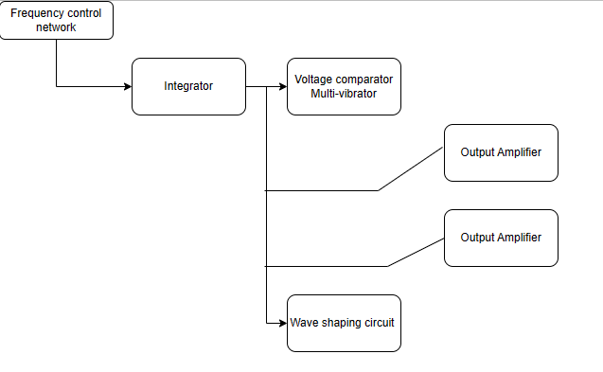
Block diagram

Slide 9
Components
Frequency Control Network: A frequency control network is a circuit or system used to control the frequency of an oscillating signal. It typically consists of components such as resistors, capacitors, and inductors, along with frequency-determining elements like crystal oscillators or timing circuits.
Integrator: An integrator is a circuit that performs the mathematical operation of integration on an input signal. It accumulates the area under the input signal curve over time, resulting in an output that is proportional to the integral of the input signal. An integrator circuit is commonly implemented using an operational amplifier (op-amp) and a capacitor.

Slide 10
Voltage Comparator: A voltage comparator is an electronic device or circuit that compares two voltage inputs and produces a digital output based on the comparison. It determines if one voltage is higher or lower than another voltage. The output of a voltage comparator is typically a binary signal, representing a logical "high" or "low" state based on the voltage comparison.
Multivibrator: A multivibrator is a circuit that generates continuous alternating output waveforms, typically in the form of square waves or pulses. It is often used for timing, clocking, and frequency generation purposes.

Slide 11
Wave Shaping Circuit: A wave shaping circuit is a circuit that modifies the shape or characteristics of an input waveform. It can reshape the waveform's amplitude, frequency, or timing characteristics. Wave shaping circuits are commonly used for signal conditioning, noise filtering, pulse shaping, and waveform distortion correction.
Output Amplifier: An output amplifier is a circuit that amplifies the signal from the previous stages of a circuit to drive a load or external device. It boosts the amplitude or power level of the signal to ensure proper signal transmission or driving capability.

Slide 12
Requirements :
f = [3,4;12]kHz ;
A□=1V
A∆=[3,6]V
Vpc=12V
Ro=5Ω

Slide 13
Circuit schematic

Slide 14
Simulations
Parametric sweep analysis involves defining a range of values or a list of discrete values for specific parameters of interest, such as resistance, capacitance, or voltage. The analysis then performs simulations for each combination of parameter values within the specified range or list.
Monte Carlo analysis allows for the evaluation of the performance and variability of a circuit by considering the statistical variations in component values.
Worst case scenario analysis involves defining the extreme values or limits for certain circuit parameters, such as component tolerances, operating conditions, or environmental factors. The analysis then evaluates the circuit performance by considering the worst-case combination of these parameters.

Slide 15
Parametric sweep

Slide 17
Monte Carlo

Slide 18
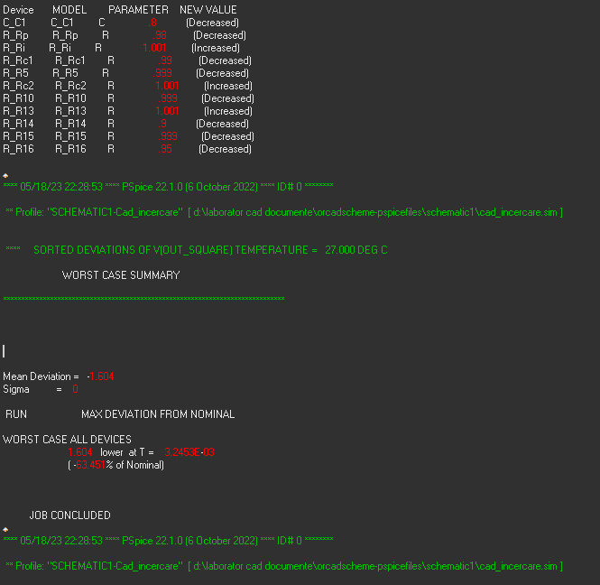
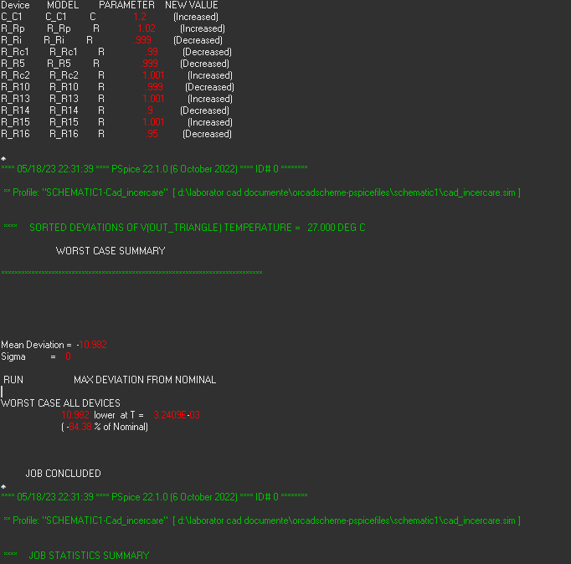
Worst Case

Slide 19
Thank you!

